Slide 1
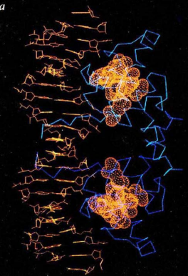
Protein Core
The Protein Core: A Target for Drug Discovery and Design

Slide 2
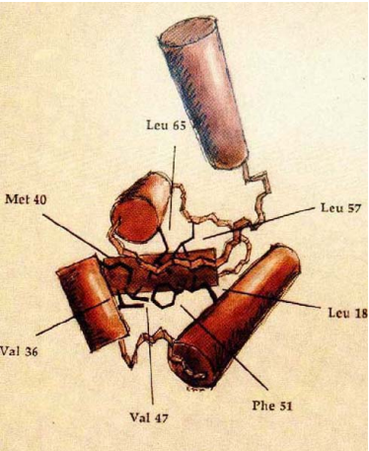
What is a protein core?
A protein core is the densely packed, inner region of a folded protein. It is primarily composed of hydrophobic amino acids that cluster together to minimize contact with water.
The core is the structural framework of the protein.
It is shielded from the aqueous environment, hydrophobic in nature.
Protein core is the part of a folded protein with zero solvent accessibility.

Slide 3
Importance of Protein Core
Stability:
Hydrophobic interactions drive core formation
Minimize contact with water, increasing stability
Function:
Essential for protein activity
Provides a framework for ligand binding and catalytic sites
Protein Folding:
Core formation is a key step in protein folding
Misfolding can lead to diseases like Alzheimer's and Parkinson's

Slide 4
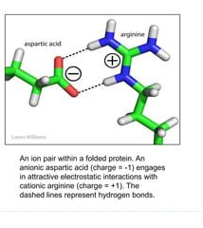
Forces Stabilizing the Protein Core
Hydrophobic Interactions:
Major driving force
Non-polar amino acids cluster together, excluding water
Van der Waals Forces:
Weak attractive forces between non-polar atoms
Contribute to overall stability
Hydrogen Bonds:
Occur between polar side chains within the core
Stabilize specific regions
Ionic Bonds:
Oppositely charged amino acids can attract each other, stabilizing the core.

Slide 5
Techniques for Studying the Protein Core
X-ray Crystallography:
High-resolution structural information
Reveals detailed atomic arrangement of the core
Nuclear Magnetic Resonance (NMR) Spectroscopy:
Provides dynamic information about the core
Can study proteins in solution

Slide 6
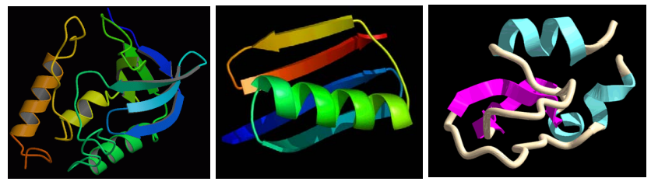
Computational Techniques to analyze Protein Core
Homology Modeling:
Utilize experimentally determined structures of homologous proteins to model the target protein.
Identify conserved core residues and predict their spatial arrangement.
Ab Initio Protein Structure Prediction:
Predict protein structure from its amino acid sequence without relying on experimental data.
Useful for proteins with no known homologs.
Molecular Dynamics Simulations:
Simulate the dynamic behavior of proteins over time.
Study the stability and flexibility of the protein core under various conditions.
Computational Mutagenesis:
Predict the effects of mutations on protein core stability and function.
Identify potential drug targets and design novel proteins.

Slide 7
Bioinformatics and Machine Learning to Study Protein Core
Sequence Analysis
Identifying patterns and motifs in protein sequences to predict core properties.
Structure Prediction
Predicting the 3D structure of proteins based on their amino acid sequences.
Function Prediction
Relating protein core features to their biological functions.

Slide 8
Implications and Applications of Protein Core Research
Drug Design
Understanding core structures aids in designing drugs that target specific proteins.
Protein Engineering
Modifying protein cores to improve stability, function, and activity.
Disease Prediction
Studying core changes associated with disease helps develop treatments.

